Slide 1

Page Replacement Algorithms for Memory Management

Slide 2
Assignment No 8- Page Replacement Algorithm
Write a program to simulate LRU page replacement algorithm.

Slide 3
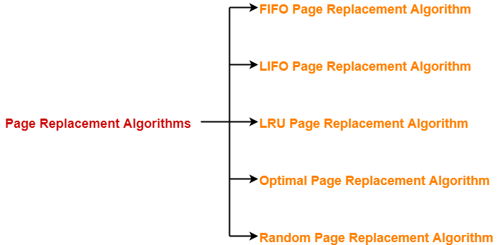
Page Replacement Algorithms

Slide 4
LRU Page Replacement Algorithm
In Least Recently Used (LRU) algorithm is a Greedy algorithm where the page to be replaced is least recently used.
The opposite of FIFO is LIFO, in which the last data entered is the first to be removed
It works on the idea that the more recently used blocks are more likely to be referenced again.
When the page requested by the program is not present in the RAM, page fault occurs and then if the page frame is full then we have to remove the page that has not been in use for the longest period of time.
It works on the idea that the more recently used blocks are more likely to be referenced again. LRU is the most frequently used algorithm as it gives less number of page faults when compared to the other algorithms.

Slide 5
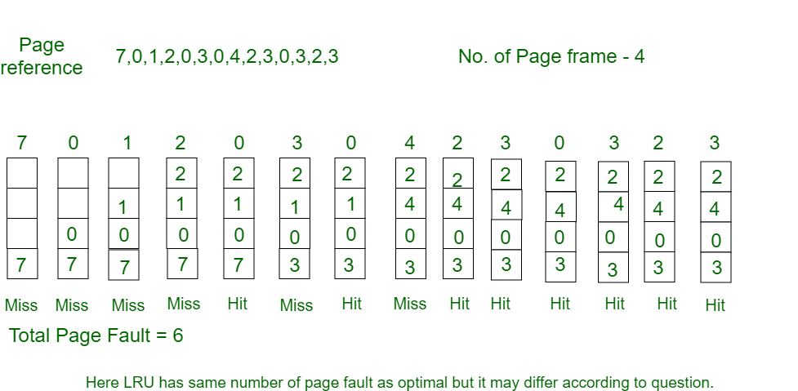
Example- Consider the page reference string 7, 0, 1, 2, 0, 3, 0, 4, 2, 3, 0, 3, 2 with 4 page frames.Find number of page faults.

Slide 6
Initially all slots are empty, so when 7 0 1 2 are allocated to the empty slots —> 4 Page faults
0 is already their so —> 0 Page fault.
when 3 came it will take the place of 7 because it is least recently used —>1 Page fault
0 is already in memory so —> 0 Page fault.
4 will takes place of 1 —> 1 Page Fault
Now for the further page reference string —> 0 Page fault because they are already available in the memory.
LRU Page Replacement Algorithm

Slide 7
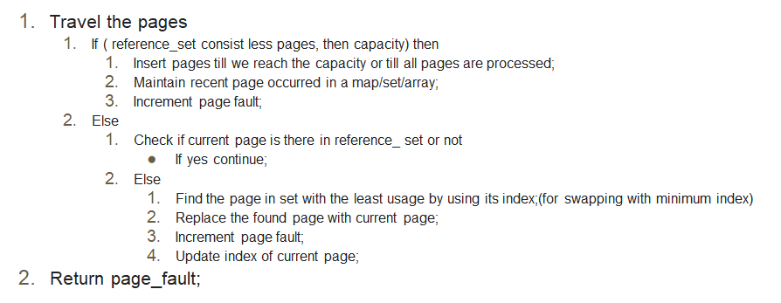
Pseudo Code - LRU

Slide 8
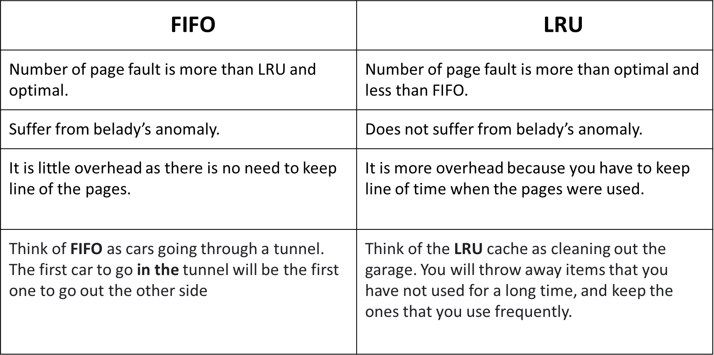
FIFO vs LRU

